Slide 1
PA1 : Multi-Image Denoising

Slide 2
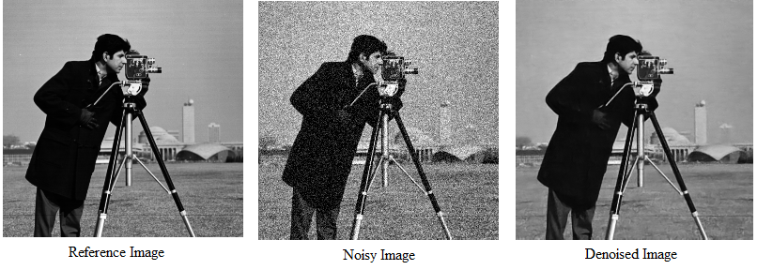
What is Denoising?
a process in digital image processing that involves removing or reducing unwanted noise from a digital image while preserving as much of the underlying, essential details as possible.
Reference: L. I. Rudin, S. Osher, and E. Fatemi. Nonlinear total variation based noise removal algorithms. In Physica D, 60(1–4):259–268, 1992.

Slide 3
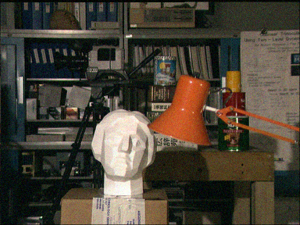

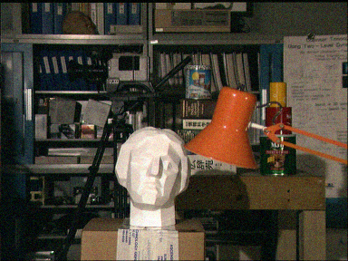
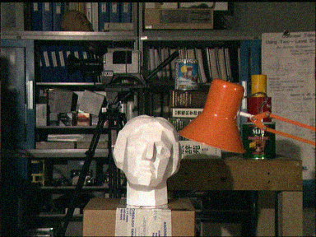
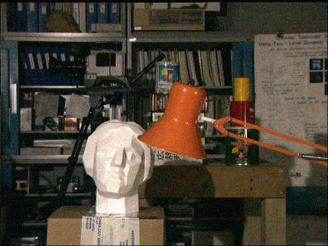
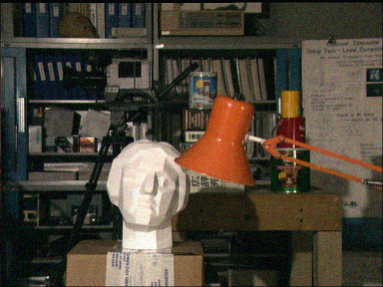
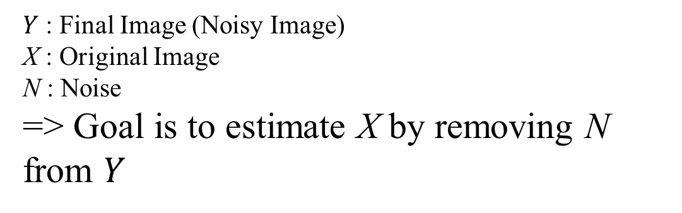
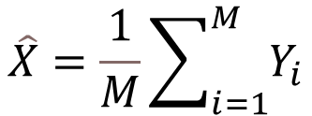

What is Denoising?
Single Image
Multi Image
$$Y=X+N$$
$Y$ : Final Image (Noisy Image)
X : Original Image
N : Noise
=> Goal is to estimate X by removing N from $Y$
$$\hat{X}=\frac{1}{M}\sum_{i=1}^{M}{Y_{i}}$$

Slide 4
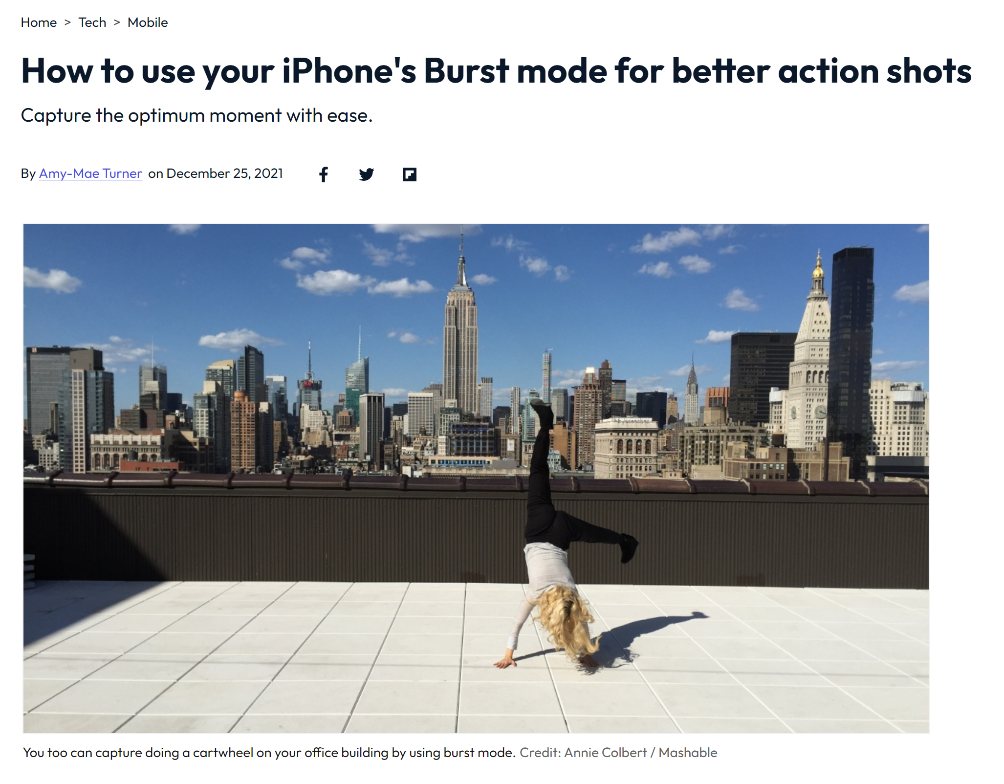
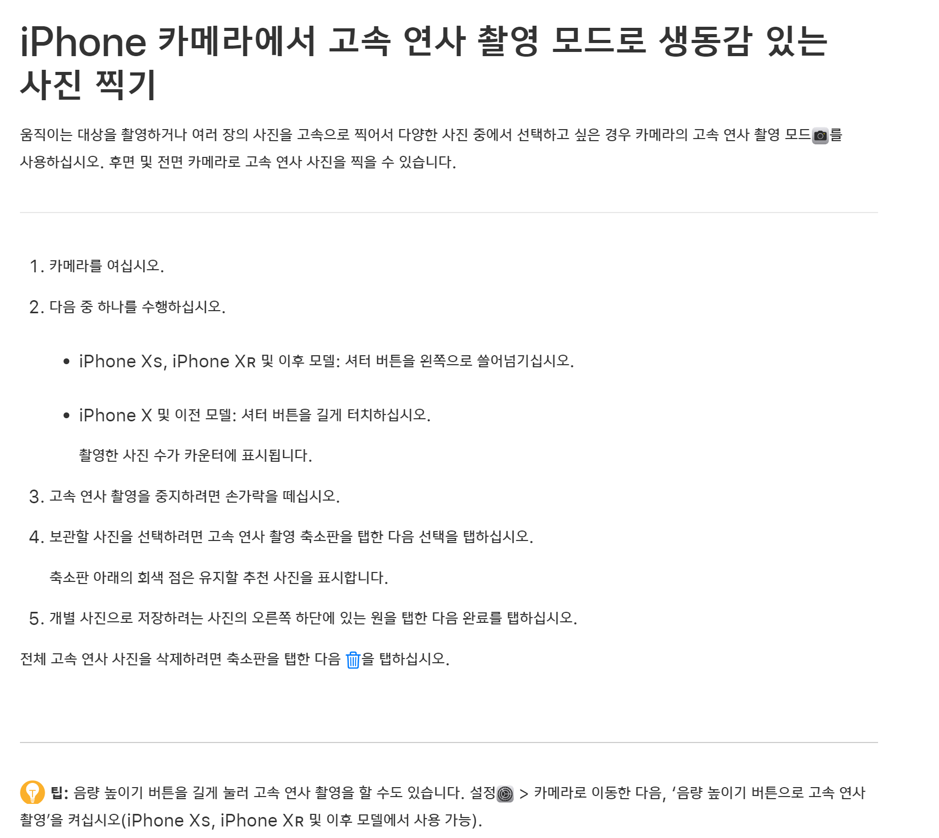
Burst shot

Slide 5
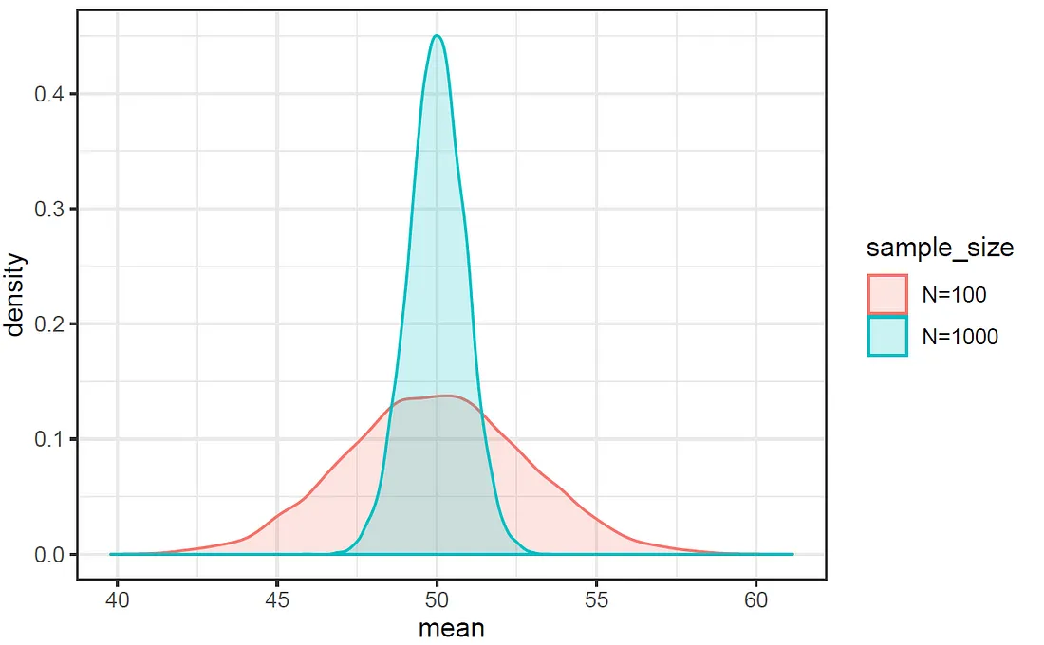
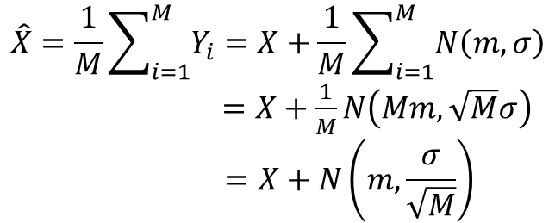
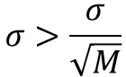
Multi Image Denoising
Central Limit Theorem: the distribution of the sum (or average) of a large number of independent, identically distributed random variables approaches a normal (Gaussian) distribution, regardless of the original distribution of the variables.
$$\hat{X}=\frac{1}{M}\sum_{i=1}^{M}{Y_{i}}=X+\frac{1}{M}\sum_{i=1}^{M}{N\left(m,σ\right)}$$
$=X+\frac{1}{M}N\left(Mm,\sqrt{M}σ\right)$
$$=X+N\left(m,\frac{σ}{\sqrt{M}}\right)$$
$$σ>\frac{σ}{\sqrt{M}}$$

Slide 6
PA1: Multi Image Denoising with Disparity
Original
Warping
Warping
Warping
Warping

Slide 7
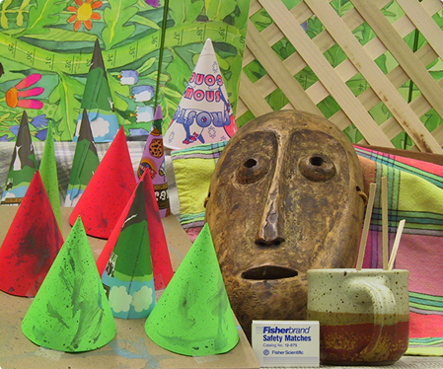
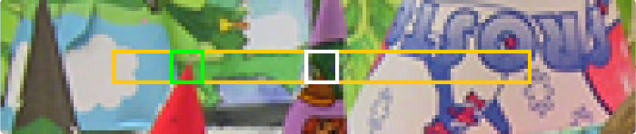

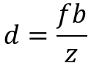
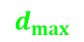
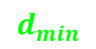
What is a disparity
the difference in image location of an object seen by the left and right eyes, resulting from the eyes' horizontal separation, used to infer depth
$$d=\frac{fb}{z}$$
$d$: depth
$f$: focal length(pixel)
$b$: baseline
$z$: disparity
$$d_{min}$$
d
$$d_{max}$$
Disparity

Slide 8
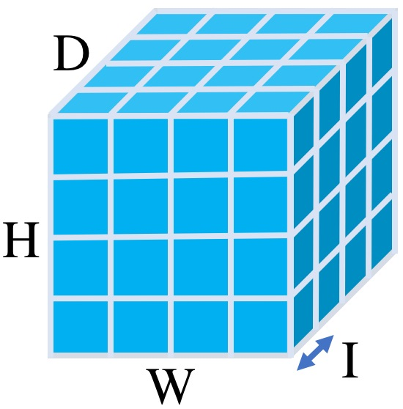
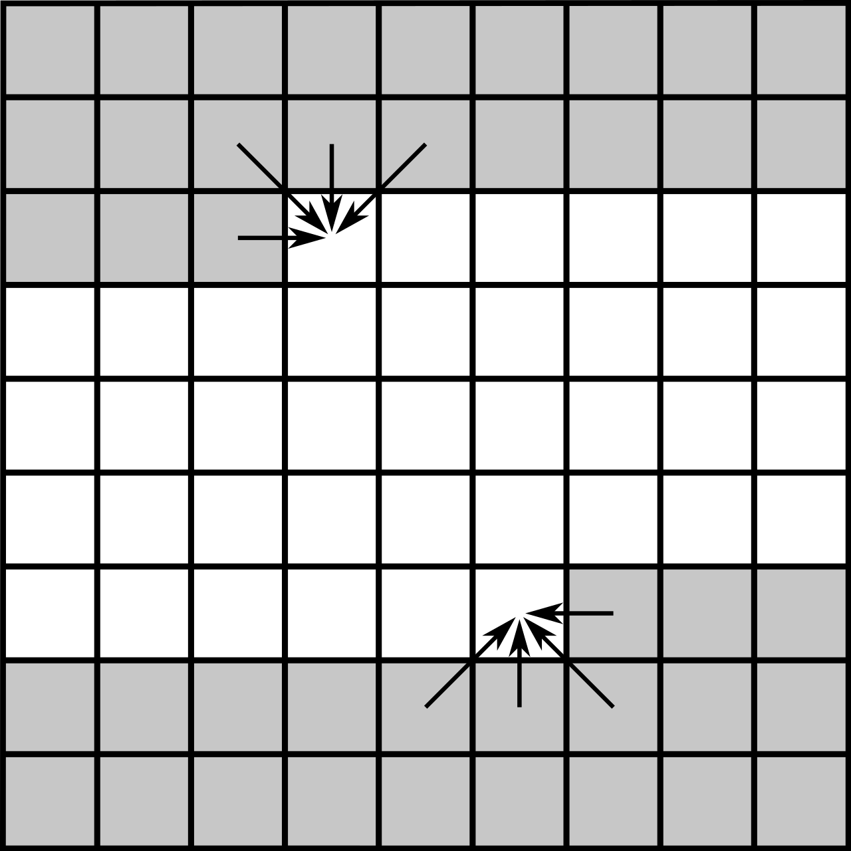
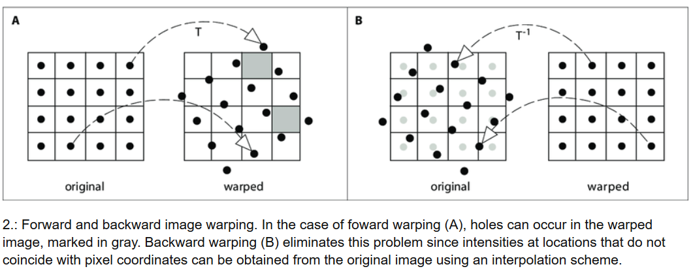
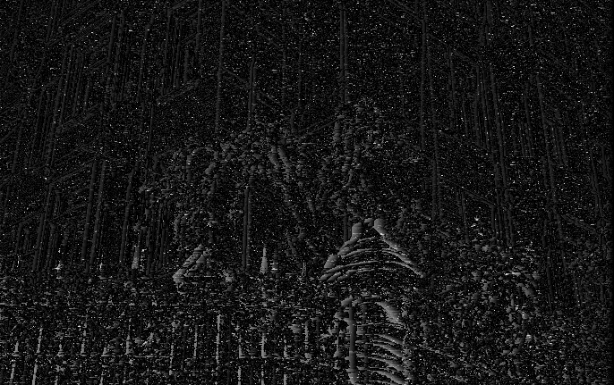
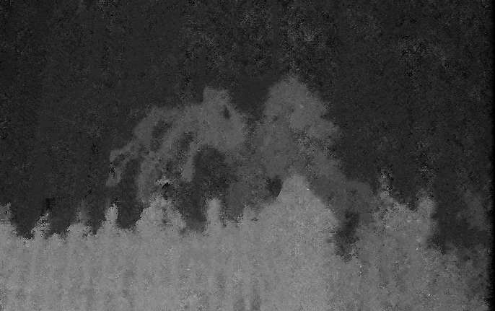
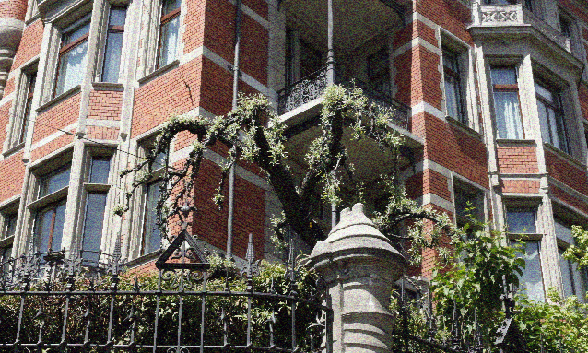
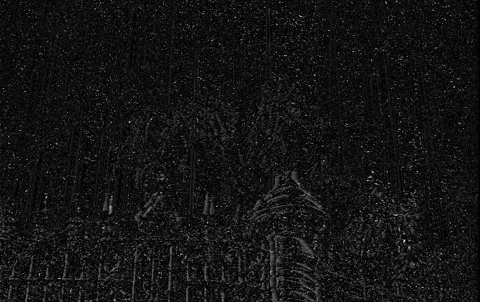
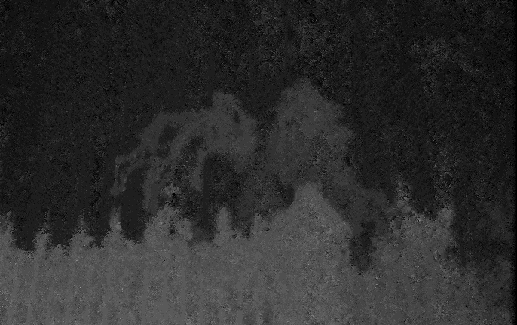
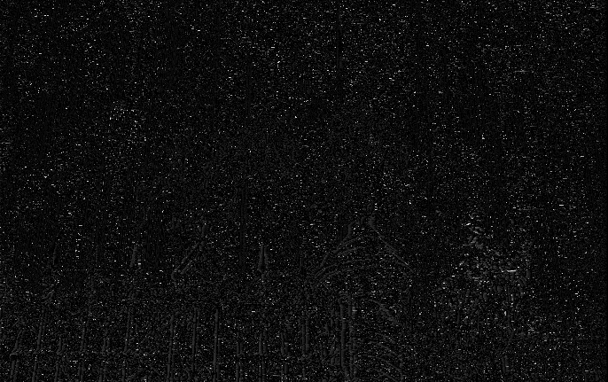
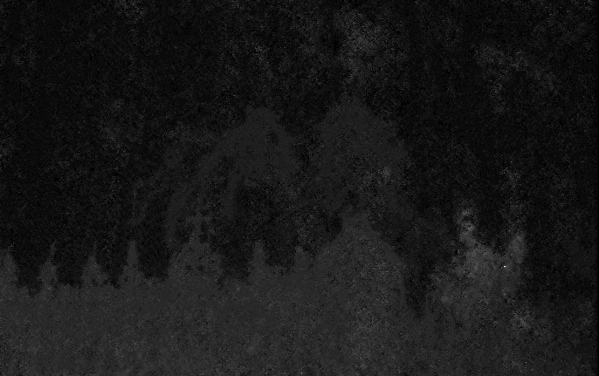
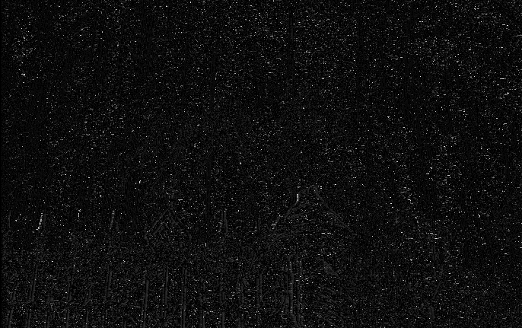
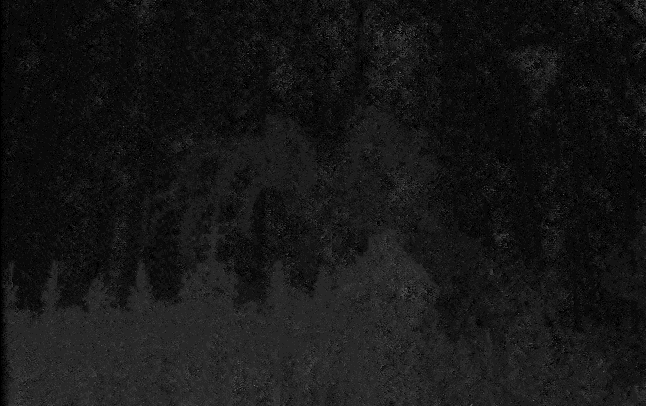
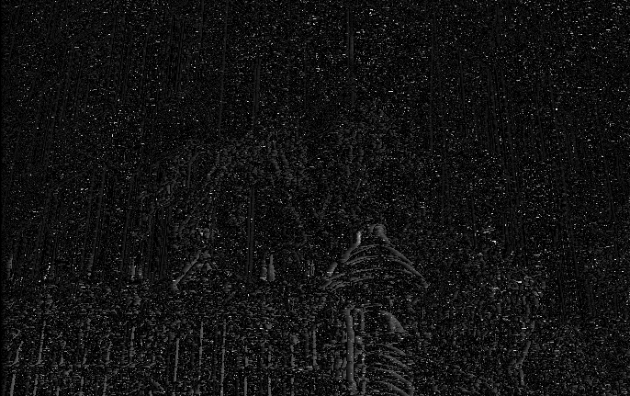
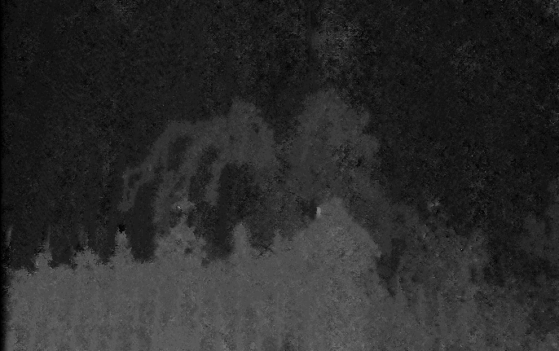
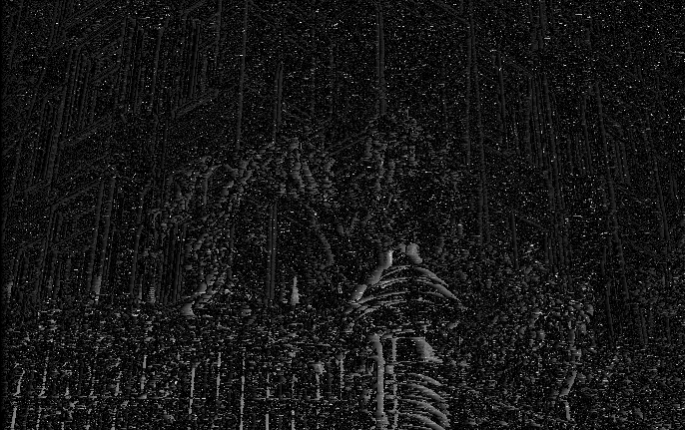
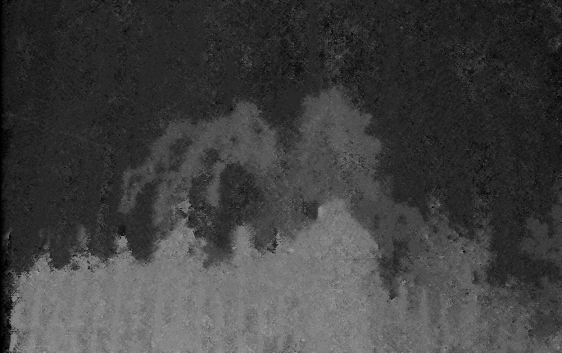
Overview of PA1
Cost Volume
Construction
Semi Global
Matching
Warping and Aggregating

Slide 9
Preliminary 1: Pixelwise similarity
Pixelwise similarity measure
SAD (Sum of Absolute Differences)
SSD (Sum of Squared Differences)
Birchfield-Tomasi Dissimilarity

Slide 10
Cost Volume
Cost for Disparity 2
Cost for Disparity 1
Cost for Disparity 0
R
L
Left Cost Volume
Right Cost Volume
R
R
L
L

Slide 11
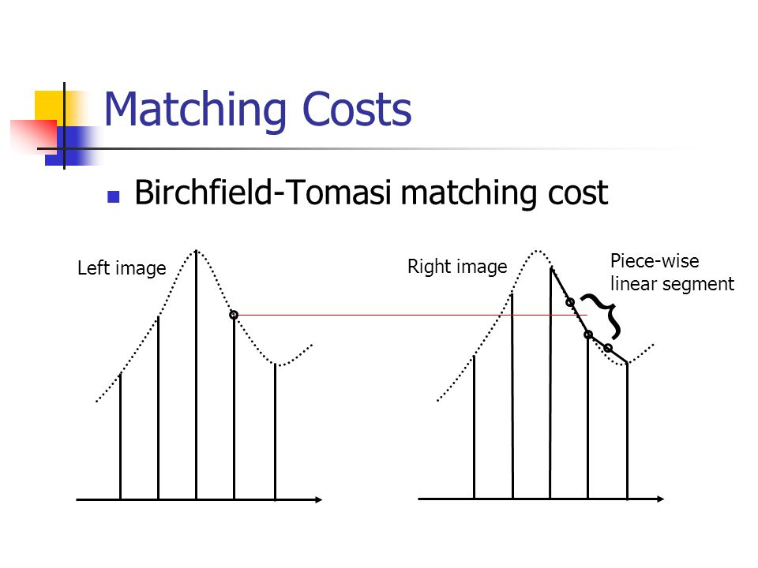
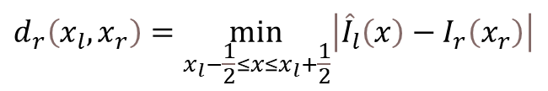
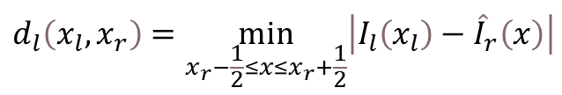
Birchfield-Tomasi Dissimilarity [Extra credit]
a pixel dissimilarity measure proposed for stereo matching that considers values within a range that extends half a pixel on either side to minimizes sampling errors, especially when there are slight misalignments between pixels.
$$d_{l}\left(x_{l},x_{r}\right)=\min_{x_{r}−\frac{1}{2}≤x≤x_{r}+\frac{1}{2}}\left|I_{l}\left(x_{l}\right)−{\hat{I}}_{r}\left(x\right)\right|$$
$$d_{l}\left(x_{l},x_{r}\right)=\max\left\{0,I_{l}\left(x_{l}\right)−I_{r max}, I_{r min}−I_{l}\left(x_{l}\right)\right\}$$
$$d_{r}\left(x_{l},x_{r}\right)=\min_{x_{l}−\frac{1}{2}≤x≤x_{l}+\frac{1}{2}}\left|{\hat{I}}_{l}\left(x\right)−I_{r}\left(x_{r}\right)\right|$$
$$d_{r}\left(x_{l},x_{r}\right)=\max\left\{0,I_{r}\left(x_{r}\right)−I_{l max}, I_{l min}−I_{r}\left(x_{r}\right)\right\}$$
$$I_{r max}=\max\left\{I_{r}\left(x_{r}\right),I_{r}^{+}\left(x_{r}\right),I_{r}^{−}\left(x_{r}\right)\right\}$$
$$I_{r min}=\min\left\{I_{r}\left(x_{r}\right),I_{r}^{+}\left(x_{r}\right),I_{r}^{−}\left(x_{r}\right)\right\}$$
$$d\left(x_{l},x_{r}\right)=\min\left\{d_{l}\left(x_{l},x_{r}\right),d_{r}\left(x_{l},x_{r}\right)\right\}$$

Slide 12
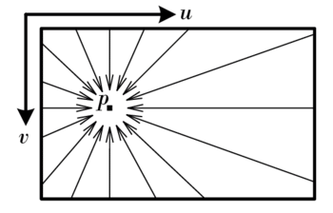
Preliminary 2: Semi Global Matching
a method to compute disparity maps which aggregates matching costs over multiple directions in the image, optimizing disparity calculations instead of considering local patches.
How to solve
Dynamic Programming (DP) is a computational technique used to solve problems by breaking them down into simpler subproblems. It avoids redundant computations by storing and reusing solutions to these subproblems.
Notes:
balance between the efficiency of local methods and the accuracy of global optimization techniques, resulting in more consistent and detailed disparity maps.

Slide 13
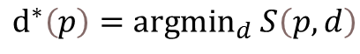
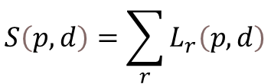
Preliminary 2: Semi Global Matching
$$S\left(p,d\right)=\sum_{r}{L_{r}\left(p,d\right)}$$
$$L_{r}\left(p,d\right)=D\left(p,d\right)+\min\left\{L_{r}\left(p−r,d\right),L_{r}\left(p−r,d−1\right)+P_{1},L_{r}\left(p−r,d+1\right)+P_{1}, \min_{ⅈ}L_{r}\left(p−r,i\right)+P_{2}\right\}−\min_{k}L_{r}\left(p−r,k\right)$$
$ⅆ^{∗}\left(p\right)={argmin}_{d}$ $S\left(p,d\right)$
$D\left(p,d\right)$: pixelwise disparity
$p$: pixel
$r$: direction
$d$: disparity
$ⅆ^{∗}\left(p\right)$: final disparity
Two passes dynamic programming, a forward pass accumulating the cost from the left, top-left, top, and top-right, and a backward pass accumulating the cost from right, bottom-right, bottom, and bottom-left.

Slide 14

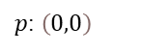

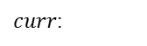

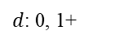

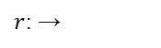

Detailed procedure
$p$: $\left(0,0\right)$
$$L_{r}\left(p,d\right)=D\left(p,d\right)+\min\left\{L_{r}\left(p−r,d\right),L_{r}\left(p−r,d−1\right)+P_{1},L_{r}\left(p−r,d+1\right)+P_{1}, \min_{ⅈ}L_{r}\left(p−r,i\right)+P_{2}\right\}−\min_{k}L_{r}\left(p−r,k\right)$$
$r$: →
$$L_{r}\left(p,d\right)=D\left(p,d\right)+\min\left\{L_{r}\left(p−r,d\right),L_{r}\left(p−r,d−1\right)+P_{1},L_{r}\left(p−r,d+1\right)+P_{1}, \min_{ⅈ}L_{r}\left(p−r,i\right)+P_{2}\right\}−\min_{k}L_{r}\left(p−r,k\right)$$
$d$: 0, 1+
$$∞$$
$$∞$$
$$∞$$
$$∞$$
$$∞$$
$$L_{r}\left(p,d\right)=D\left(p,d\right)+\min\left\{L_{r}\left(p−r,d\right),L_{r}\left(p−r,d−1\right)+P_{1},L_{r}\left(p−r,d+1\right)+P_{1}, \min_{ⅈ}L_{r}\left(p−r,i\right)+P_{2}\right\}−\min_{k}L_{r}\left(p−r,k\right)$$
$curr$:
Single
Same with other disparity

Slide 15
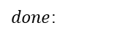
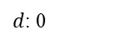

Detailed procedure - forward
$p$: $\left(0,1\right)$
$$L_{r}\left(p,d\right)=D\left(p,d\right)+\min\left\{L_{r}\left(p−r,d\right),L_{r}\left(p−r,d−1\right)+P_{1},L_{r}\left(p−r,d+1\right)+P_{1}, \min_{ⅈ}L_{r}\left(p−r,i\right)+P_{2}\right\}−\min_{k}L_{r}\left(p−r,k\right)$$
$r$: →
$d$: 0
$curr$:
$done$:

Slide 16
Detailed procedure - forward
$p$: $\left(0,1\right)$
$$L_{r}\left(p,d\right)=D\left(p,d\right)+\min\left\{L_{r}\left(p−r,d\right),L_{r}\left(p−r,d−1\right)+P_{1},L_{r}\left(p−r,d+1\right)+P_{1}, \min_{ⅈ}L_{r}\left(p−r,i\right)+P_{2}\right\}−\min_{k}L_{r}\left(p−r,k\right)$$
$r$: →
$d$: 0
$curr$:
$done$:

Slide 17

Detailed procedure - forward
$p$: $\left(0,1\right)$
$$L_{r}\left(p,d\right)=D\left(p,d\right)+\min\left\{L_{r}\left(p−r,d\right),L_{r}\left(p−r,d−1\right)+P_{1},L_{r}\left(p−r,d+1\right)+P_{1}, \min_{ⅈ}L_{r}\left(p−r,i\right)+P_{2}\right\}−\min_{k}L_{r}\left(p−r,k\right)$$
$$∞$$
$r$: →
$d$: 0
$curr$:
$done$:

Slide 18

Detailed procedure - forward
$p$: $\left(0,1\right)$
$$L_{r}\left(p,d\right)=D\left(p,d\right)+\min\left\{L_{r}\left(p−r,d\right),L_{r}\left(p−r,d−1\right)+P_{1},L_{r}\left(p−r,d+1\right)+P_{1}, \min_{ⅈ}L_{r}\left(p−r,i\right)+P_{2}\right\}−\min_{k}L_{r}\left(p−r,k\right)$$
$$∞$$
$r$: →
$d$: 0
$curr$:
$done$:

Slide 19
Detailed procedure - forward
$p$: $\left(0,1\right)$
$$L_{r}\left(p,d\right)=D\left(p,d\right)+\min\left\{L_{r}\left(p−r,d\right),L_{r}\left(p−r,d−1\right)+P_{1},L_{r}\left(p−r,d+1\right)+P_{1}, \min_{ⅈ}L_{r}\left(p−r,i\right)+P_{2}\right\}−\min_{k}L_{r}\left(p−r,k\right)$$
$$∞$$
$r$: →
$d$: 0
$curr$:
$done$:

Slide 20
Detailed procedure - forward
$p$: $\left(0,1\right)$
$$L_{r}\left(p,d\right)=D\left(p,d\right)+\min\left\{L_{r}\left(p−r,d\right),L_{r}\left(p−r,d−1\right)+P_{1},L_{r}\left(p−r,d+1\right)+P_{1}, \min_{ⅈ}L_{r}\left(p−r,i\right)+P_{2}\right\}−\min_{k}L_{r}\left(p−r,k\right)$$
$$∞$$
$r$: →
$d$: 0
$curr$:
$done$:

Slide 21
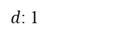
Detailed procedure - forward
$p$: $\left(0,1\right)$
$$L_{r}\left(p,d\right)=D\left(p,d\right)+\min\left\{L_{r}\left(p−r,d\right),L_{r}\left(p−r,d−1\right)+P_{1},L_{r}\left(p−r,d+1\right)+P_{1}, \min_{ⅈ}L_{r}\left(p−r,i\right)+P_{2}\right\}−\min_{k}L_{r}\left(p−r,k\right)$$
$r$: →
$d$: 1
$curr$:
$done$:

Slide 22
Detailed procedure - forward
$p$: $\left(0,1\right)$
$$L_{r}\left(p,d\right)=D\left(p,d\right)+\min\left\{L_{r}\left(p−r,d\right),L_{r}\left(p−r,d−1\right)+P_{1},L_{r}\left(p−r,d+1\right)+P_{1}, \min_{ⅈ}L_{r}\left(p−r,i\right)+P_{2}\right\}−\min_{k}L_{r}\left(p−r,k\right)$$
$r$: →
$d$: 1
$curr$:
$done$:

Slide 23
Detailed procedure - forward
$p$: $\left(0,1\right)$
$$L_{r}\left(p,d\right)=D\left(p,d\right)+\min\left\{L_{r}\left(p−r,d\right),L_{r}\left(p−r,d−1\right)+P_{1},L_{r}\left(p−r,d+1\right)+P_{1}, \min_{ⅈ}L_{r}\left(p−r,i\right)+P_{2}\right\}−\min_{k}L_{r}\left(p−r,k\right)$$
$r$: →
$d$: 1
$curr$:
$done$:

Slide 24
Detailed procedure - forward
$p$: $\left(0,1\right)$
$$L_{r}\left(p,d\right)=D\left(p,d\right)+\min\left\{L_{r}\left(p−r,d\right),L_{r}\left(p−r,d−1\right)+P_{1},L_{r}\left(p−r,d+1\right)+P_{1}, \min_{ⅈ}L_{r}\left(p−r,i\right)+P_{2}\right\}−\min_{k}L_{r}\left(p−r,k\right)$$
$r$: →
$d$: 1
$curr$:
$done$:

Slide 25
Detailed procedure - forward
$p$: $\left(0,1\right)$
$$L_{r}\left(p,d\right)=D\left(p,d\right)+\min\left\{L_{r}\left(p−r,d\right),L_{r}\left(p−r,d−1\right)+P_{1},L_{r}\left(p−r,d+1\right)+P_{1}, \min_{ⅈ}L_{r}\left(p−r,i\right)+P_{2}\right\}−\min_{k}L_{r}\left(p−r,k\right)$$
$r$: →
$d$: 1
$curr$:
$done$:

Slide 26
Detailed procedure - forward
$p$: $\left(0,1\right)$
$$L_{r}\left(p,d\right)=D\left(p,d\right)+\min\left\{L_{r}\left(p−r,d\right),L_{r}\left(p−r,d−1\right)+P_{1},L_{r}\left(p−r,d+1\right)+P_{1}, \min_{ⅈ}L_{r}\left(p−r,i\right)+P_{2}\right\}−\min_{k}L_{r}\left(p−r,k\right)$$
$r$: →
$d$: 1
$curr$:
$done$:

Slide 27
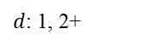
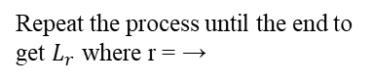
Detailed procedure - forward
$p$: $\left(0,1\right)$
$$L_{r}\left(p,d\right)=D\left(p,d\right)+\min\left\{L_{r}\left(p−r,d\right),L_{r}\left(p−r,d−1\right)+P_{1},L_{r}\left(p−r,d+1\right)+P_{1}, \min_{ⅈ}L_{r}\left(p−r,i\right)+P_{2}\right\}−\min_{k}L_{r}\left(p−r,k\right)$$
$r$: →
$d$: 1, 2+
$curr$:
$done$:
Same with other disparity
Repeat the process until the end to get $L_{r}$ where r = →

Slide 28
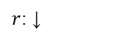
Detailed procedure
$p$: $\left(0,0\right)$
$$L_{r}\left(p,d\right)=D\left(p,d\right)+\min\left\{L_{r}\left(p−r,d\right),L_{r}\left(p−r,d−1\right)+P_{1},L_{r}\left(p−r,d+1\right)+P_{1}, \min_{ⅈ}L_{r}\left(p−r,i\right)+P_{2}\right\}−\min_{k}L_{r}\left(p−r,k\right)$$
$r$: ↓
$$L_{r}\left(p,d\right)=D\left(p,d\right)+\min\left\{L_{r}\left(p−r,d\right),L_{r}\left(p−r,d−1\right)+P_{1},L_{r}\left(p−r,d+1\right)+P_{1}, \min_{ⅈ}L_{r}\left(p−r,i\right)+P_{2}\right\}−\min_{k}L_{r}\left(p−r,k\right)$$
$d$: 0, 1+
$$∞$$
$$∞$$
$$∞$$
$$∞$$
$$∞$$
$$L_{r}\left(p,d\right)=D\left(p,d\right)+\min\left\{L_{r}\left(p−r,d\right),L_{r}\left(p−r,d−1\right)+P_{1},L_{r}\left(p−r,d+1\right)+P_{1}, \min_{ⅈ}L_{r}\left(p−r,i\right)+P_{2}\right\}−\min_{k}L_{r}\left(p−r,k\right)$$
$curr$:
Single
Same with other disparity

Slide 29


Detailed procedure
$p$: $\left(0,1^{+}\right)$
$$L_{r}\left(p,d\right)=D\left(p,d\right)+\min\left\{L_{r}\left(p−r,d\right),L_{r}\left(p−r,d−1\right)+P_{1},L_{r}\left(p−r,d+1\right)+P_{1}, \min_{ⅈ}L_{r}\left(p−r,i\right)+P_{2}\right\}−\min_{k}L_{r}\left(p−r,k\right)$$
$r$: ↓
$$L_{r}\left(p,d\right)=D\left(p,d\right)+\min\left\{L_{r}\left(p−r,d\right),L_{r}\left(p−r,d−1\right)+P_{1},L_{r}\left(p−r,d+1\right)+P_{1}, \min_{ⅈ}L_{r}\left(p−r,i\right)+P_{2}\right\}−\min_{k}L_{r}\left(p−r,k\right)$$
$d$: 0+
$$∞$$
$$∞$$
$$∞$$
$$∞$$
$$∞$$
$$L_{r}\left(p,d\right)=D\left(p,d\right)+\min\left\{L_{r}\left(p−r,d\right),L_{r}\left(p−r,d−1\right)+P_{1},L_{r}\left(p−r,d+1\right)+P_{1}, \min_{ⅈ}L_{r}\left(p−r,i\right)+P_{2}\right\}−\min_{k}L_{r}\left(p−r,k\right)$$
$curr$:
Same with other disparity

Slide 30

Detailed procedure - forward
$p$: $\left(1,0\right)$
$$L_{r}\left(p,d\right)=D\left(p,d\right)+\min\left\{L_{r}\left(p−r,d\right),L_{r}\left(p−r,d−1\right)+P_{1},L_{r}\left(p−r,d+1\right)+P_{1}, \min_{ⅈ}L_{r}\left(p−r,i\right)+P_{2}\right\}−\min_{k}L_{r}\left(p−r,k\right)$$
$r$: ↓
$d$: 0
$curr$:
$done$:

Slide 31
Detailed procedure - forward
$p$: $\left(1,0\right)$
$$L_{r}\left(p,d\right)=D\left(p,d\right)+\min\left\{L_{r}\left(p−r,d\right),L_{r}\left(p−r,d−1\right)+P_{1},L_{r}\left(p−r,d+1\right)+P_{1}, \min_{ⅈ}L_{r}\left(p−r,i\right)+P_{2}\right\}−\min_{k}L_{r}\left(p−r,k\right)$$
$r$: ↓
$d$: 0
$curr$:
$done$:

Slide 32
Detailed procedure - forward
$p$: $\left(1,0\right)$
$$L_{r}\left(p,d\right)=D\left(p,d\right)+\min\left\{L_{r}\left(p−r,d\right),L_{r}\left(p−r,d−1\right)+P_{1},L_{r}\left(p−r,d+1\right)+P_{1}, \min_{ⅈ}L_{r}\left(p−r,i\right)+P_{2}\right\}−\min_{k}L_{r}\left(p−r,k\right)$$
$$∞$$
$r$: ↓
$d$: 0
$curr$:
$done$:

Slide 33
Detailed procedure - forward
$p$: $\left(1,0\right)$
$$L_{r}\left(p,d\right)=D\left(p,d\right)+\min\left\{L_{r}\left(p−r,d\right),L_{r}\left(p−r,d−1\right)+P_{1},L_{r}\left(p−r,d+1\right)+P_{1}, \min_{ⅈ}L_{r}\left(p−r,i\right)+P_{2}\right\}−\min_{k}L_{r}\left(p−r,k\right)$$
$$∞$$
$r$: ↓
$d$: 0
$curr$:
$done$:

Slide 34
Detailed procedure - forward
$p$: $\left(1,0\right)$
$$L_{r}\left(p,d\right)=D\left(p,d\right)+\min\left\{L_{r}\left(p−r,d\right),L_{r}\left(p−r,d−1\right)+P_{1},L_{r}\left(p−r,d+1\right)+P_{1}, \min_{ⅈ}L_{r}\left(p−r,i\right)+P_{2}\right\}−\min_{k}L_{r}\left(p−r,k\right)$$
$$∞$$
$r$: ↓
$d$: 0
$curr$:
$done$:

Slide 35

Detailed procedure - forward
$p$: $\left(1,0\right)$
$$L_{r}\left(p,d\right)=D\left(p,d\right)+\min\left\{L_{r}\left(p−r,d\right),L_{r}\left(p−r,d−1\right)+P_{1},L_{r}\left(p−r,d+1\right)+P_{1}, \min_{ⅈ}L_{r}\left(p−r,i\right)+P_{2}\right\}−\min_{k}L_{r}\left(p−r,k\right)$$
$$∞$$
$r$: ↓
$d$: 0
$curr$:
Repeat the process until the end to get $L_{r}$ where r = ↓
$done$:
Do same for other direction in forward pass and complete backward pass same way

Slide 36






Detailed procedure
$$S\left(p,d\right)=\sum_{r}{L_{r}\left(p,d\right)}$$
$$⋯$$
$$L_{→}$$
$$L_{→}$$
$$L_{→}$$
$$L_{→}$$
Average
$$S$$

Slide 37
Preliminary 3: Warping
a process of transforming or distorting an image, typically by applying geometric changes, such as stretching, rotating, or skewing. Warping using disparity involves adjusting the position of pixels in an image based on the calculated disparity values.

Slide 38


Preliminary 4: Metric
MSE (Mean Square Error) = $\frac{{\left(I_{gt}−I\right)}^{2}}{H⋅W}$
where $H$: height, $W$: width, $I_{gt}$:Ground Truth Image, $I$:Denoised Image
PSNR (Peak Signal to Noise Ratio) = $10\log_{10}\left(\frac{R^{2}}{MSE}\right)$
Where R: maximum value of pixel of images
(e.g. uint8 type image: R=255, float type image: R=1.0)

Slide 39

Guideline
Load the required data.
Construct the cost volume using pixelwise similarity between the central image and the other images.
If the reference image is the left image, select the left cost volume. If it's the right image, select the right cost volume.
Use Semi Global Matching to derive the disparity map.
Warp image based on the disparity
Aggregate warped images
Since there's a loss of information of $d$ pixels at the cost volume borders, crop $d$ pixels from all edges.
Calculate the MSE and PSNR between the aggregated image and the GT.
Download data and skeletons from https://github.com/ihojun887/CV2023_PA1/tree/main

Slide 40




Guideline
Skeleton code

Slide 41
Guideline
Not allow to use OpenCV, Pillow functions except below :
Image I/O function
Image visualization function
cv2.cvtColor()
Not allow to use Numpy functions except below :
Numpy I/O function
np.abs, np.mean, np.square, np.log10, np.min, np.max, np.sum, np.minimum, np.maximum
np.zeros, np.copy, np.full, np.isfinite
.astype(), .shape
For languages other than Python, you can only use the function with same functionality
If you think other functions are mandatory, please contact TA

Slide 42

Submission
Submission should include…
Source code
Result of your code
Readme file explaining how to execute the program
Report (3pts)
Report should include…
Your understanding of each steps of algorithms
Figures of results from your implementation
Cost from initial cost volume - $ⅆ^{∗}\left(p\right)={argmin}_{d} CostVolume$
Each disparities from Semi Global Matching
Aggregated warped image
Notice
[Delayed submission] Not allowed
[Plagiarism] Definitely F grade for copied codes (from friends or internet)

Slide 43
Scoring criteria
Construct the cost volume for each pair of stereo image (4pt)
Extra credit when constructing cost volume with Birchfield-Tomasi Dissimilarity instead of SAD or SSD. In this case, no need to implement SAD or SSD. (2pt)
Derive the disparity map using Semi Global Matching (5pt)
Warp each images based on each disparity map (3pt)
Aggregate images (2pt)
Calculate the MSE and PSNR (3pt)
Report (3pt)
Total 20pt + 2pt

Slide 44
















Example
$$=$$
$$+ N$$
Hyper-parameter
$d$=24 (Cost Volume)
$P_{1}$=5 (Semi Global Matching)
$P_{2}$=150 (Semi Global Matching)
$r$=16 direction (Semi Global Matching, 4, 8, 16 recommended)
With the simple pixel-level calculations, the Semi Global Matching algorithm takes approximately 5 minutes to compute a single disparity under the given conditions, proportional to depth and ray count
Computed Disparity
Ground Truth
Computed Disparity
Ground Truth

Slide 45




Example – noise15
PSNR: 24.79 dB
PSNR: 27.12 dB

Slide 46
PSNR guideline
Noise10: 28.28 dB → 30.10 dB
Noise12.5: 26.39 dB → 29.24 dB
Noise15: 24.89 dB → 28.33 dB
Noise25: 20.62 dB → 25.24 dB

Slide 47
QnA
Converting the image to grayscale before calculating the disparity is recommended.
Before using the Semi-Global Matching (SGM) algorithm, it is normal for the disparity to have only vague contours. Refer to Slide 8 and try moving the image to observe the samples. But after SGM, the disparity should look fine.
In stereo images, the same object appears in the right part of the left image and the left part of the right image. The cost volume is designed to compute this, so if the left image is fixed, move the right image to the right while performing calculations. This way, costs are calculated for semantically equivalent regions.
When computing the cost volume, convert it to floating-point values to prevent underflow or overflow issues.
When computing the cost volume using a patchwise approach, setting the patch size to 1x1 pixel is equivalent to performing pixelwise calculations. In other words, you can choose either patchwise or pixelwise computation.
The basic hyper-parameters are listed on Slide 44. It is both allowed to use same hyper-parameters or change them.

Slide 48
Information
Due Date: Sep. 27 11:55pm
NEVER COPY! PLAGIARISM IS STRICTLY FORBIDDEN!
All tricks such as simply changing the name of variables or wrapping into the functions will be regarded to plagiarism.
Please submit codes, results and reports.
Additional credits: up to 5pts ( Best Result / Report 2pts + Ideas for improvement 3pts )
Additional credit can be earned if you submit notable reports, code or results.
If you have any questions about PA1, please contact TA
TA: Hojoon Lee (이호준)
E-mail: ihjnlee379@gm.gist.ac.kr
Office Hour: 1:30pm~3:00pm (Mon & Wed)
Office Location: Electrical Engineering and Computer Science Building C, Room 405
Call: 062-715-6375

